Slide 1



ML/DL for Everyone with
Lecture 5: Linear regression
in PyTorch way
Sung Kim <hunkim+ml@gmail.com> HKUST
Code: https://github.com/hunkim/PyTorchZeroToAll
Slides: http://bit.ly/PyTorchZeroAll

Slide 2

Call for Comments
Please feel free to add comments directly on these slides.
Other slides: http://bit.ly/PyTorchZeroAll
Picture from http://www.tssablog.org/archives/3280

Slide 3
ML/DL for Everyone with
Lecture 5: Linear regression
in PyTorch way
Sung Kim <hunkim+ml@gmail.com> HKUST
Code: https://github.com/hunkim/PyTorchZeroToAll
Slides: http://bit.ly/PyTorchZeroAll

Slide 4

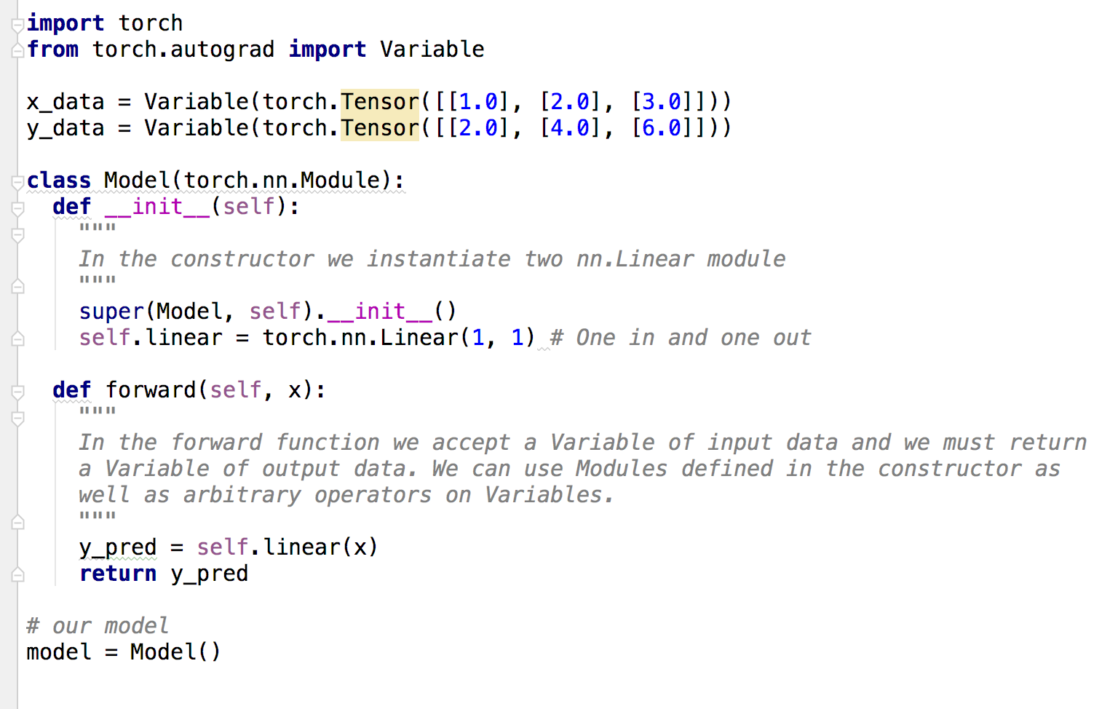
Data definition (3x1)

Slide 5
Model class in PyTorch way

Slide 6
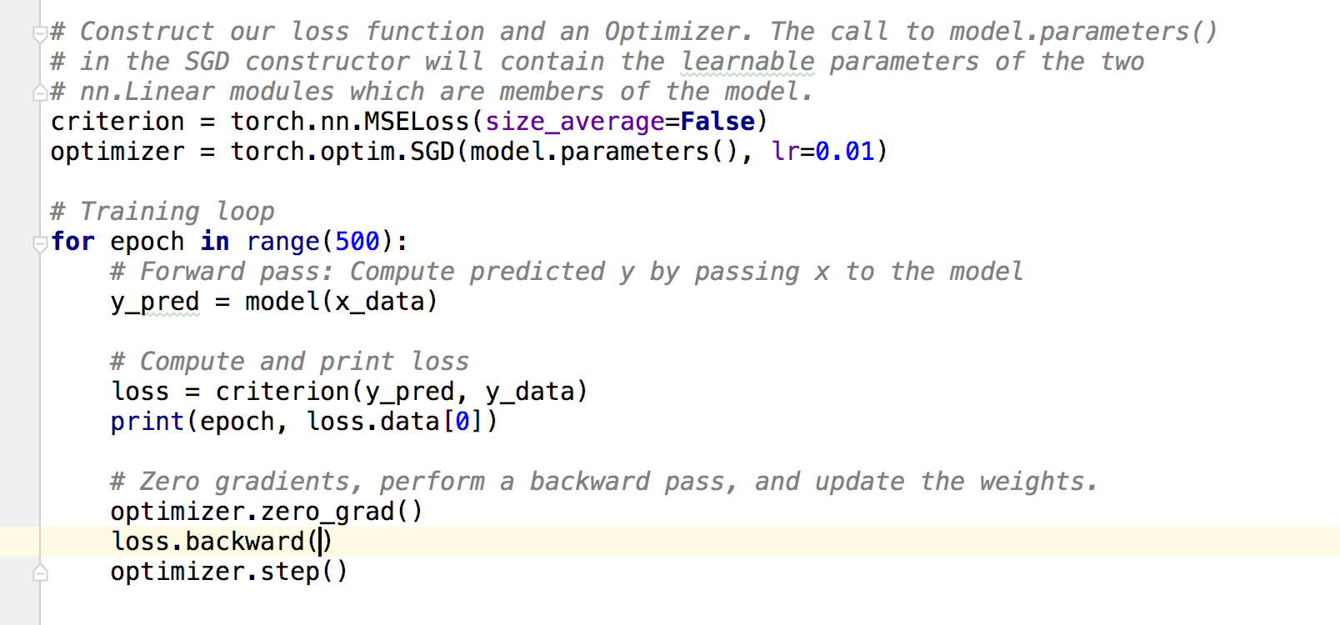
Construct loss and optimizer
https://github.com/jcjohnson/pytorch-examples

Slide 7
Training: forward, loss, backward, step
https://github.com/jcjohnson/pytorch-examples

Slide 8
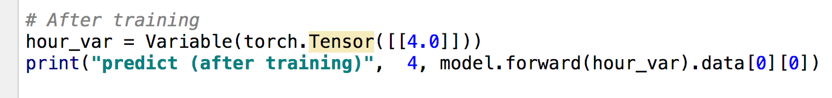
Testing Model
https://github.com/jcjohnson/pytorch-examples

Slide 9
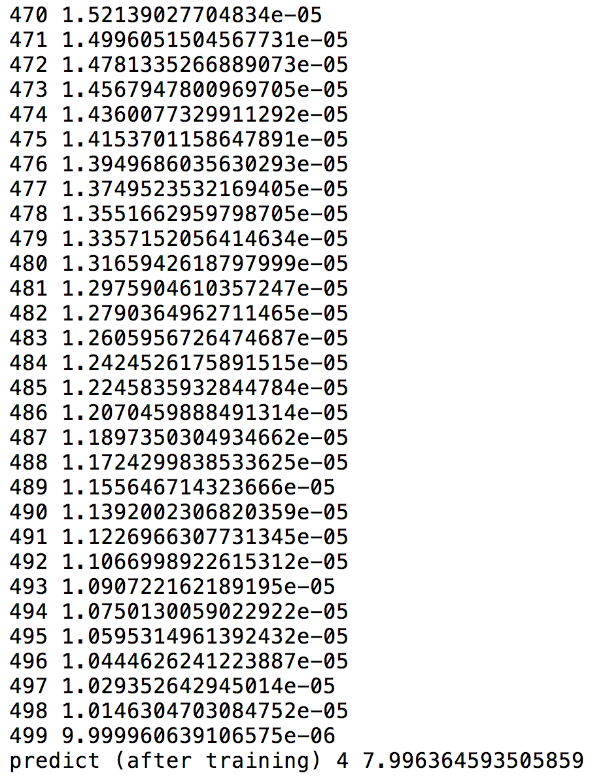
Output
https://github.com/jcjohnson/pytorch-examples

Slide 10
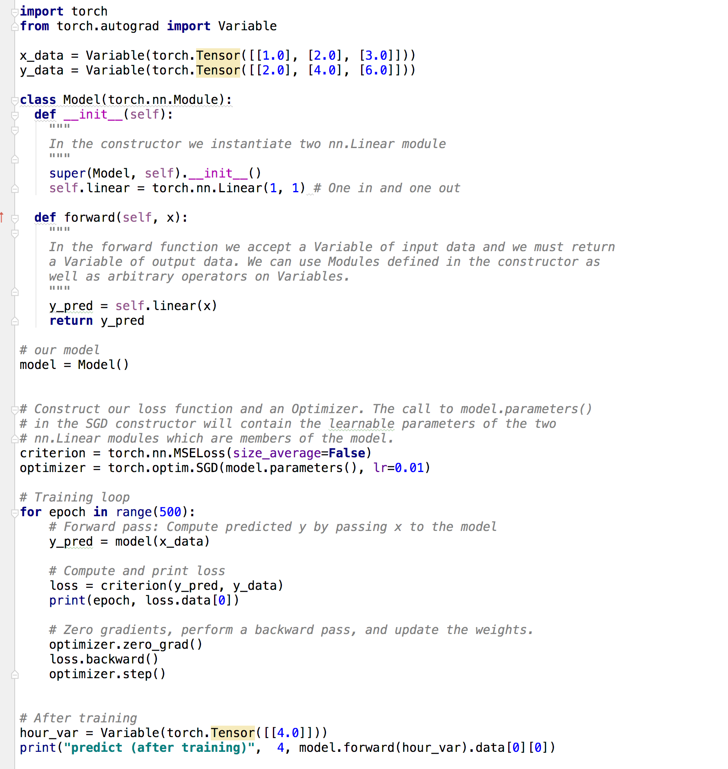

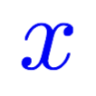
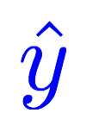


Design your model using class
Linear
Construct loss and optimizer
(select from PyTorch API)
Training cycle
(forward, backward, update)

Slide 11
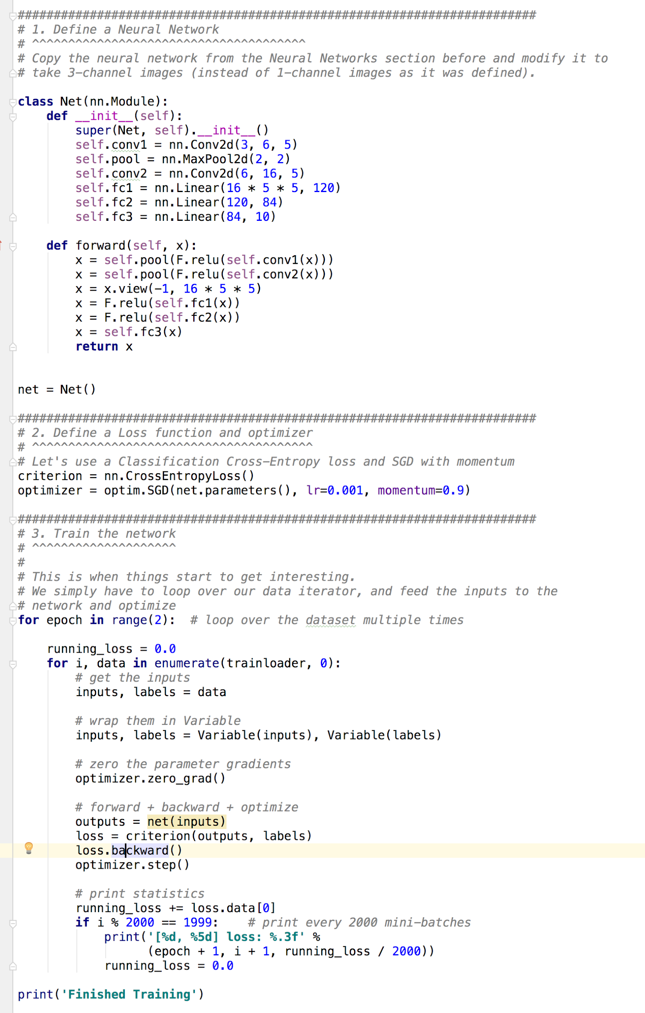
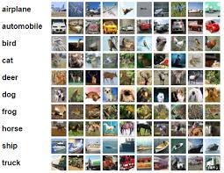
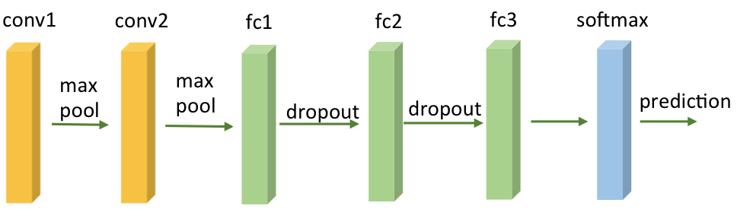
Training CIFAR10 Classifier
Design your model using class
Construct loss and optimizer
(select from PyTorch API)
Training cycle
(forward, backward, update)
http://pytorch.org/tutorials/beginner/blitz/cifar10_tutorial.html

Slide 12
Building fun models
Neural Net components
CNN
RNN
Activations
Losses
Optimizers

Slide 13
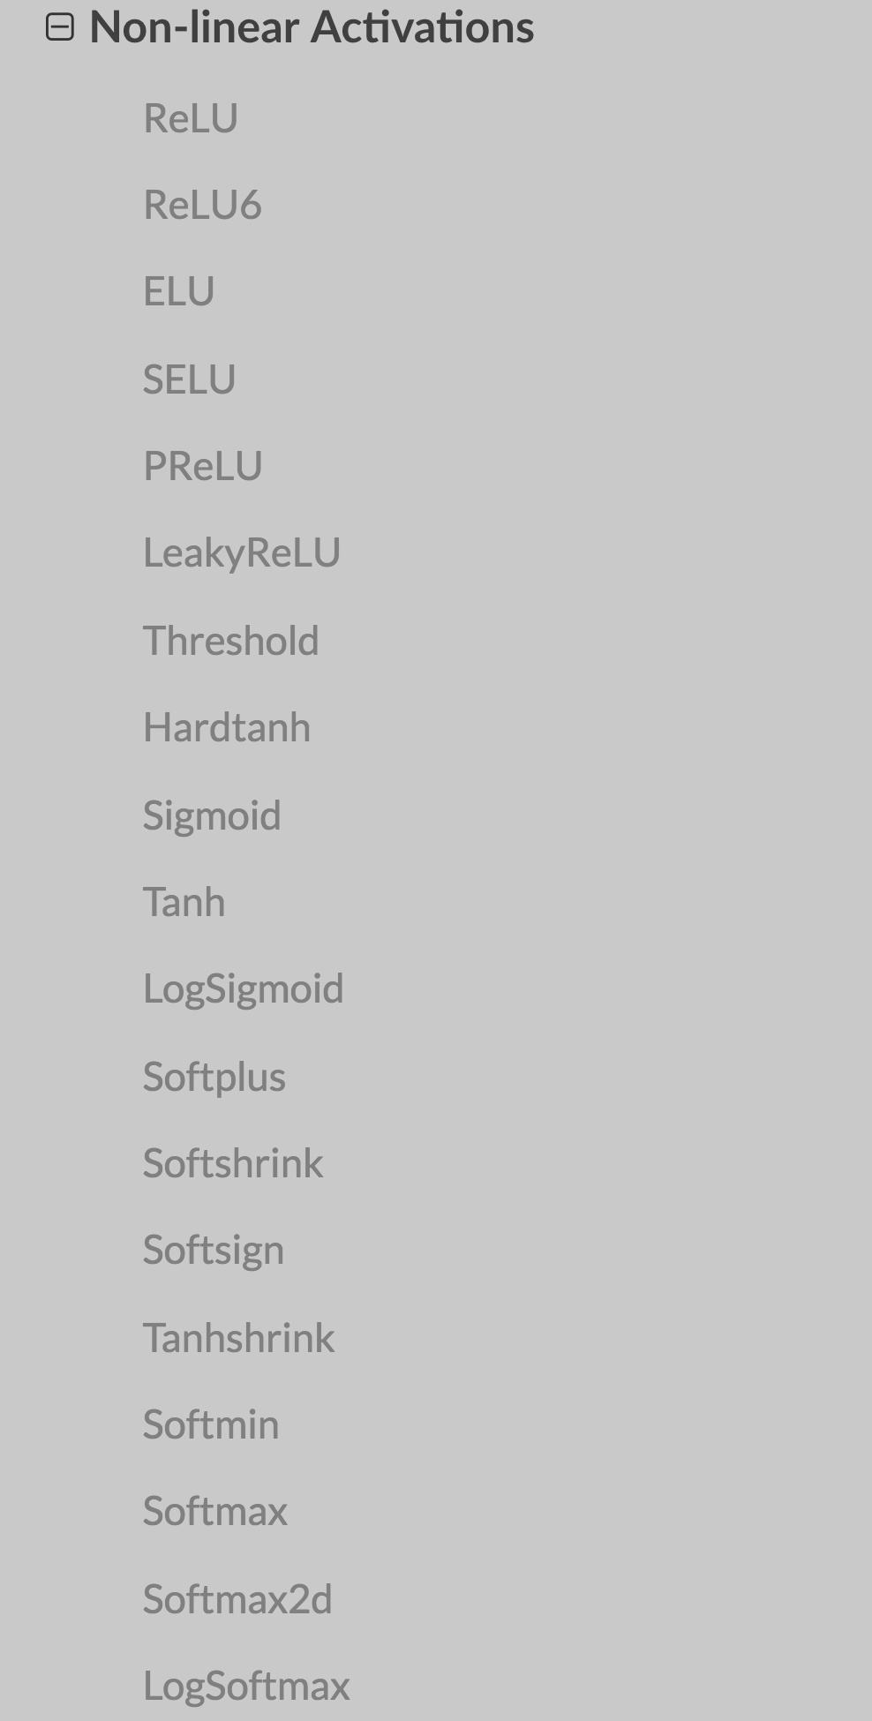
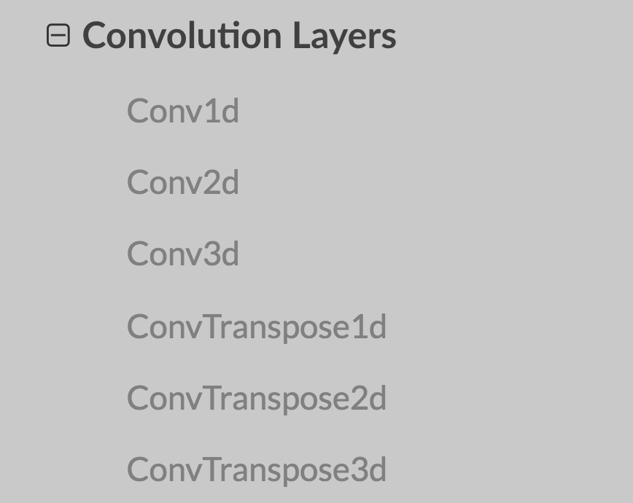

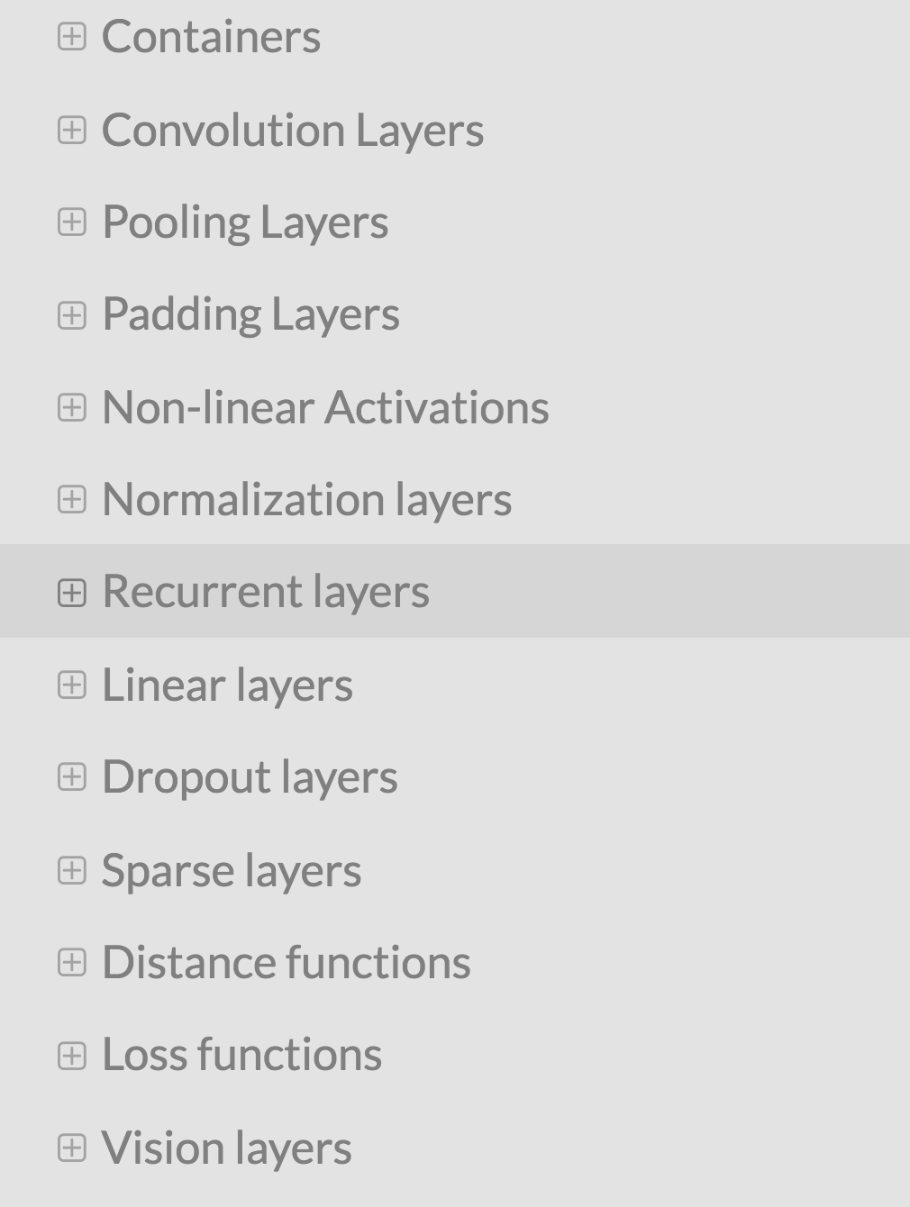
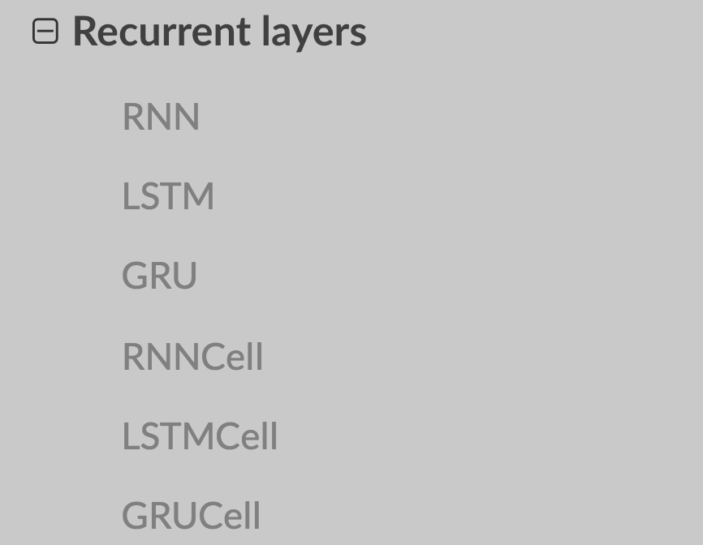
torch.nn
http://pytorch.org/docs/master/nn.html

Slide 14
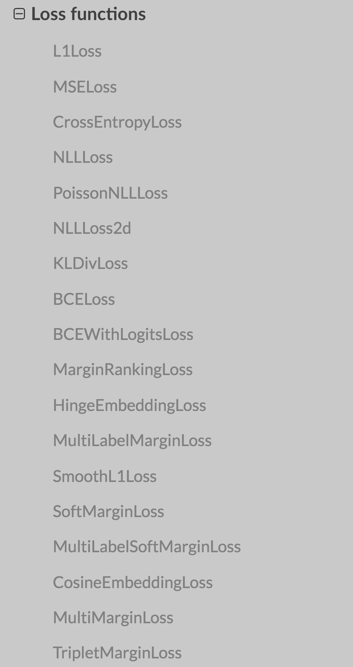
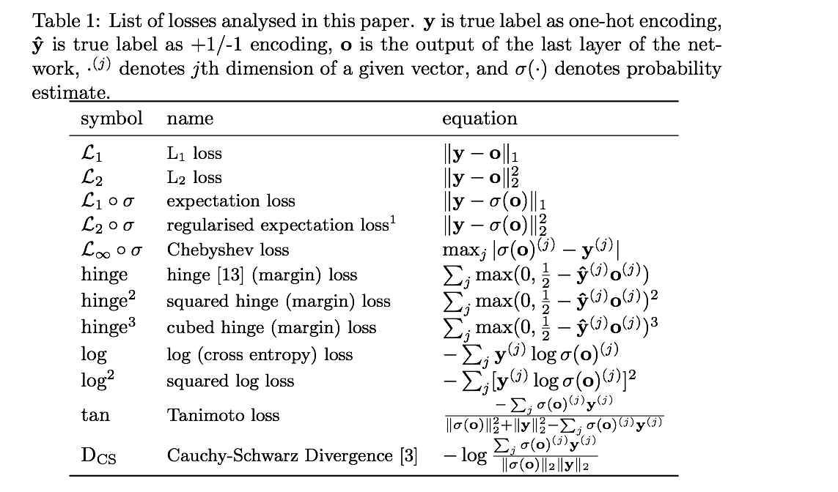
Loss functions
https://arxiv.org/pdf/1702.05659.pdf
http://pytorch.org/docs/master/nn.html

Slide 15
torch.optim
classtorch.optim.Adadelta
classtorch.optim.Adagrad
classtorch.optim.Adam
classtorch.optim.Adamax
classtorch.optim.ASGD
classtorch.optim.RMSprop
classtorch.optim.Rprop
classtorch.optim.SGD
http://pytorch.org/docs/master/optim.html

Slide 16
Three simple steps
Design your model using class
Construct loss and optimizer
(select from PyTorch API)
Training cycle
(forward, backward, update)

Slide 17


Lecture 6:
Logistic regression

